Slide 1



Maven Market_Report
View in Power BI
Last data refresh:
22/02/2026 03:24:58 UTC
Downloaded at:
22/02/2026 03:28:41 UTC

Slide 2
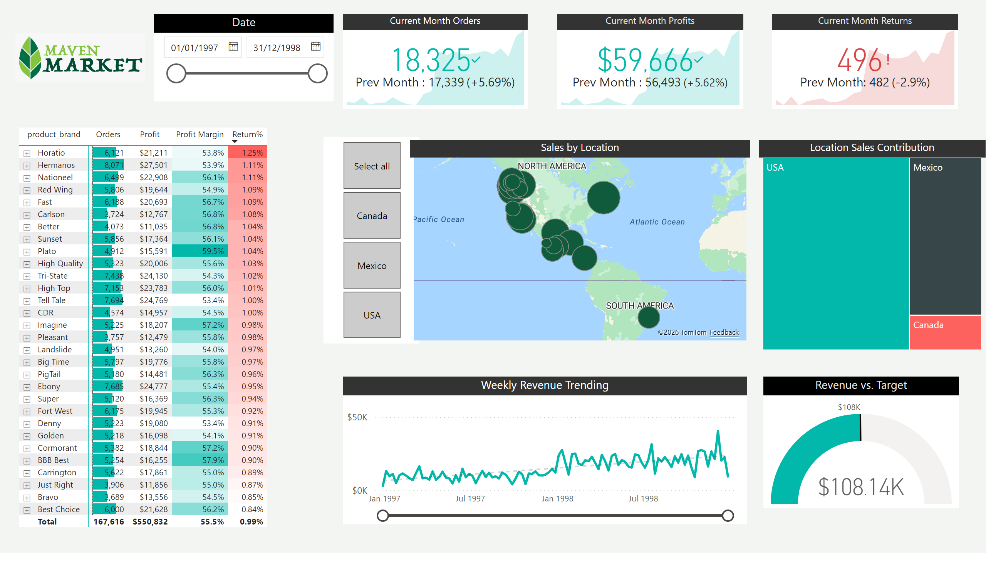
Topline Performance
Notes:
image
No alt text provided
Sales by Location
No alt text provided
Weekly Revenue Trending
No alt text provided
Current Month Returns
No alt text provided
TOP 30 Products
No alt text provided
Location Sales Contribution
No alt text provided
Current Month Orders
No alt text provided
Current Month Profits
No alt text provided
slicer
No alt text provided
Revenue vs. Target
No alt text provided
Date
No alt text provided

Slide 3
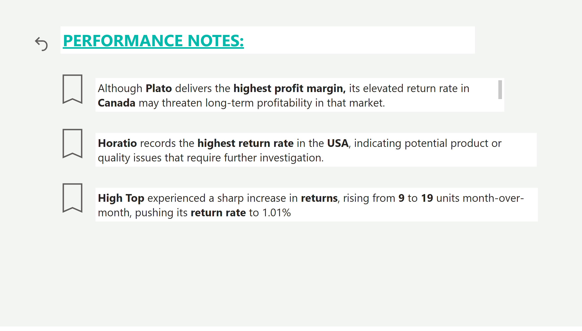
Key Performance Highlights
Notes:
actionButton
No alt text provided
Back to Dashboard
No alt text provided
actionButton
No alt text provided
actionButton
No alt text provided
textbox
No alt text provided
textbox
No alt text provided
textbox
No alt text provided
textbox
No alt text provided

